Slide 2
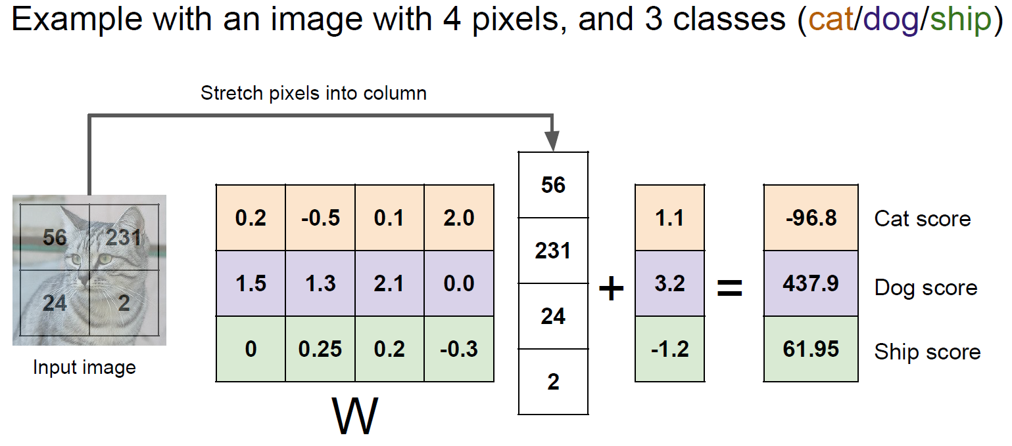
Image Classification Pipeline

Slide 3
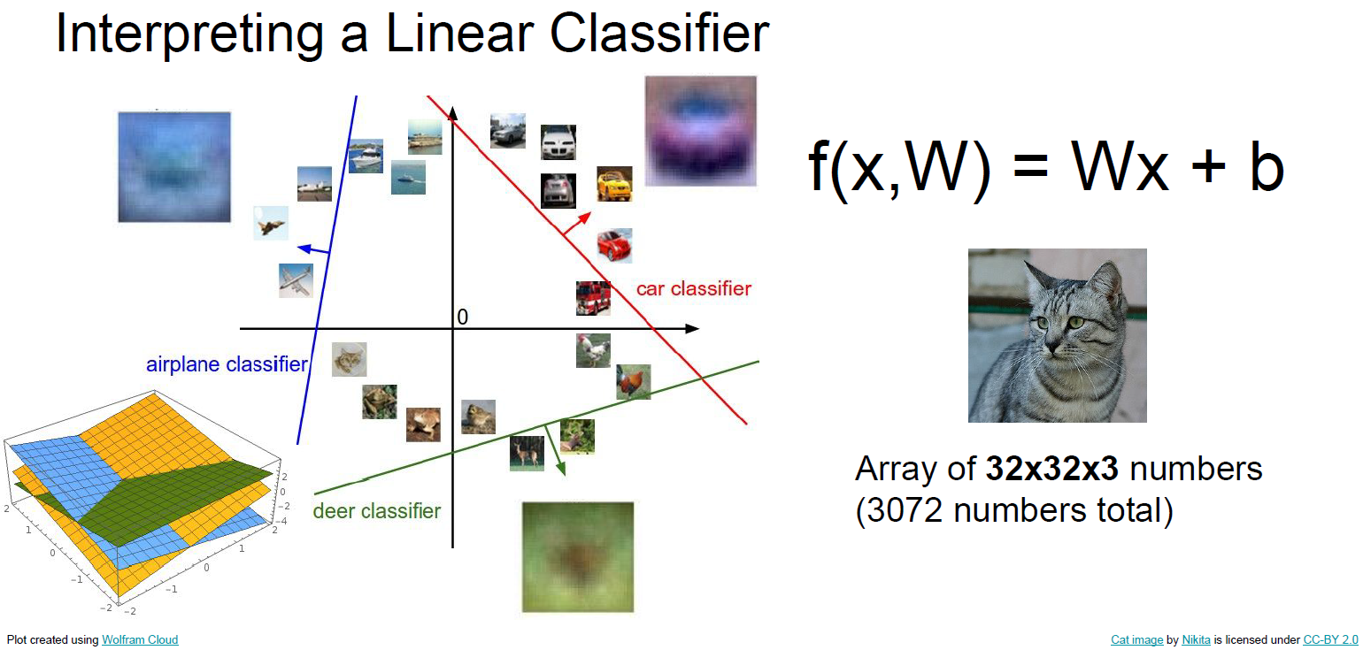
Image Classification Pipeline

Slide 4
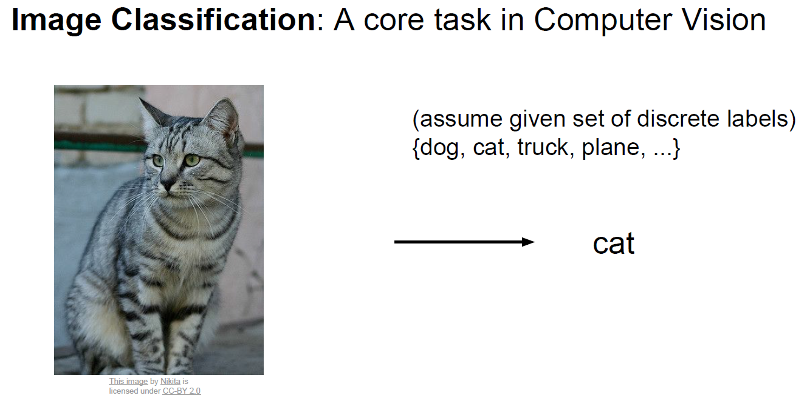
Image Classification Pipeline

Slide 5
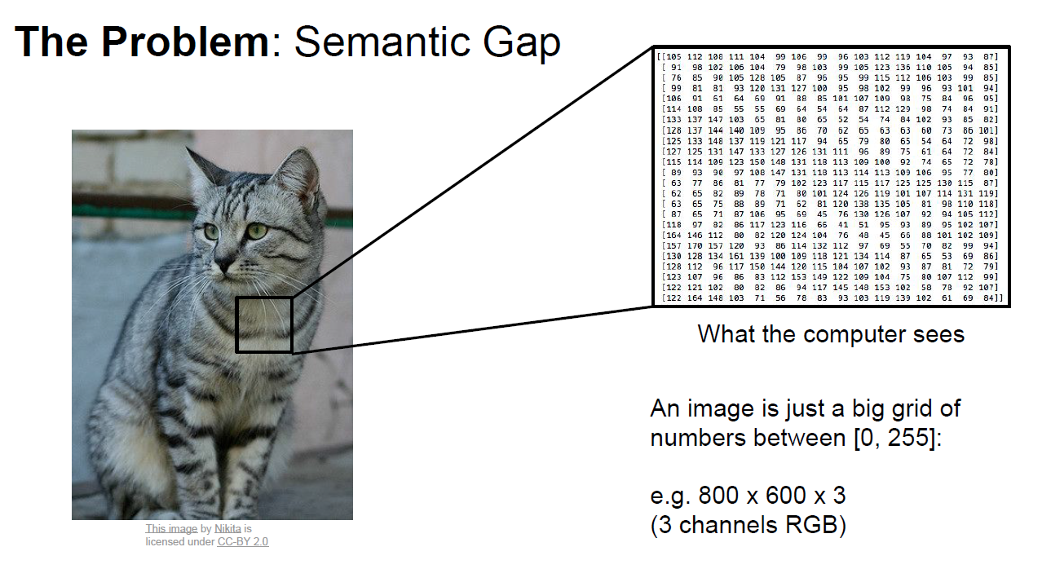
Image Classification Pipeline

Slide 6
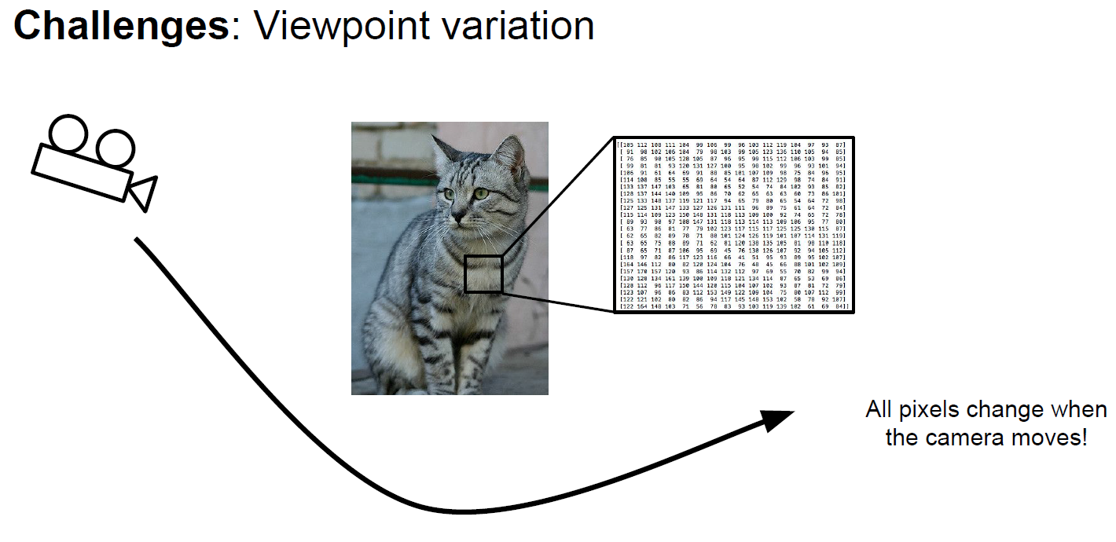
Image Classification Pipeline

Slide 7
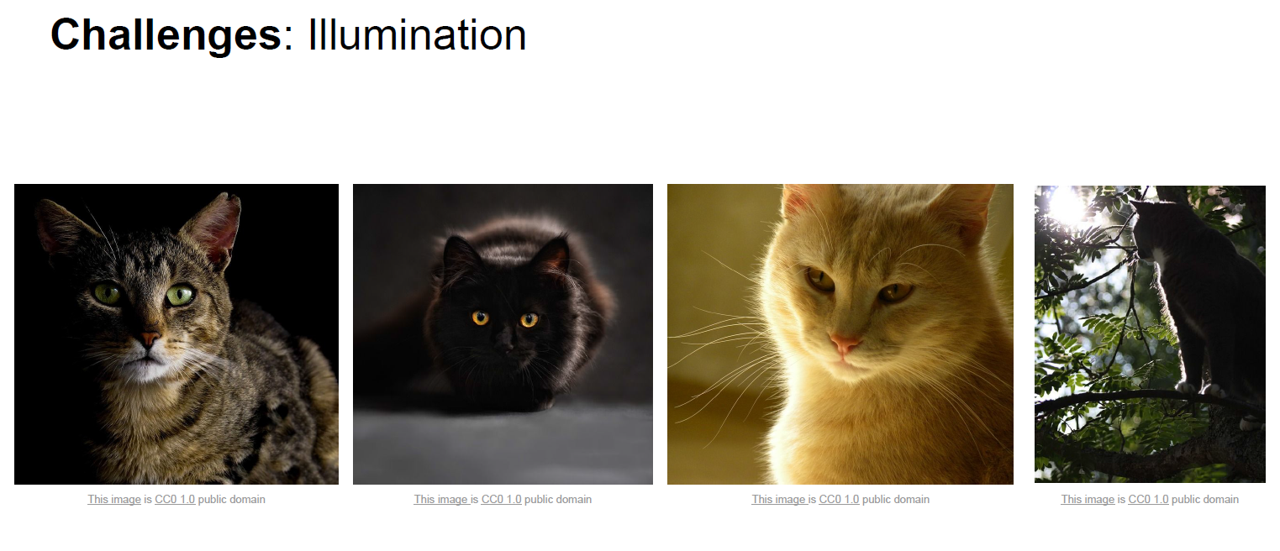
Image Classification Pipeline

Slide 8
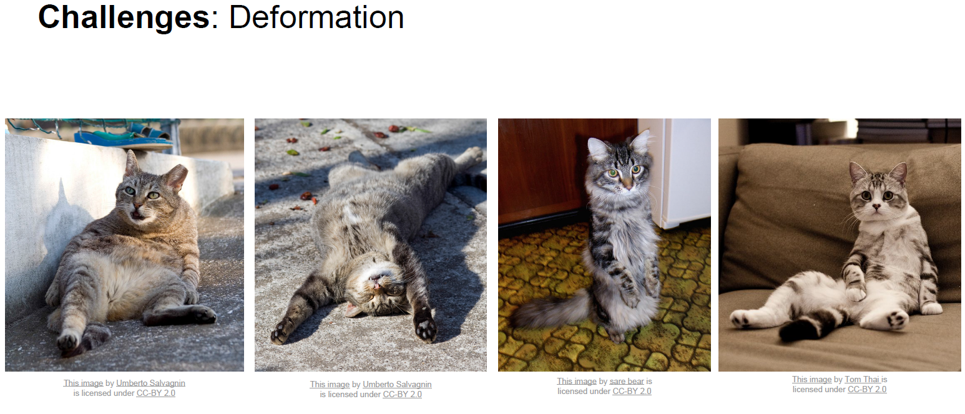
Image Classification Pipeline

Slide 9
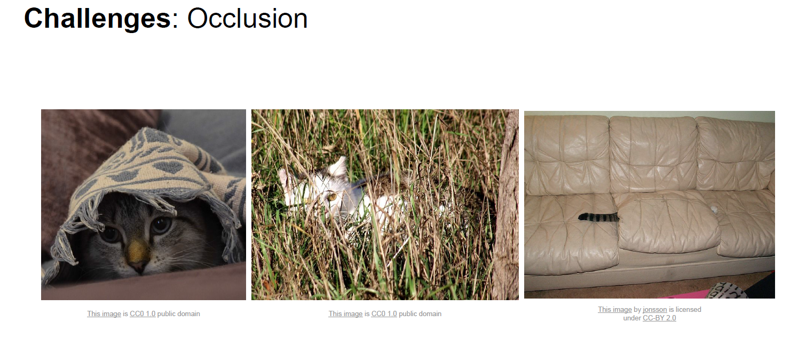
Image Classification Pipeline

Slide 10
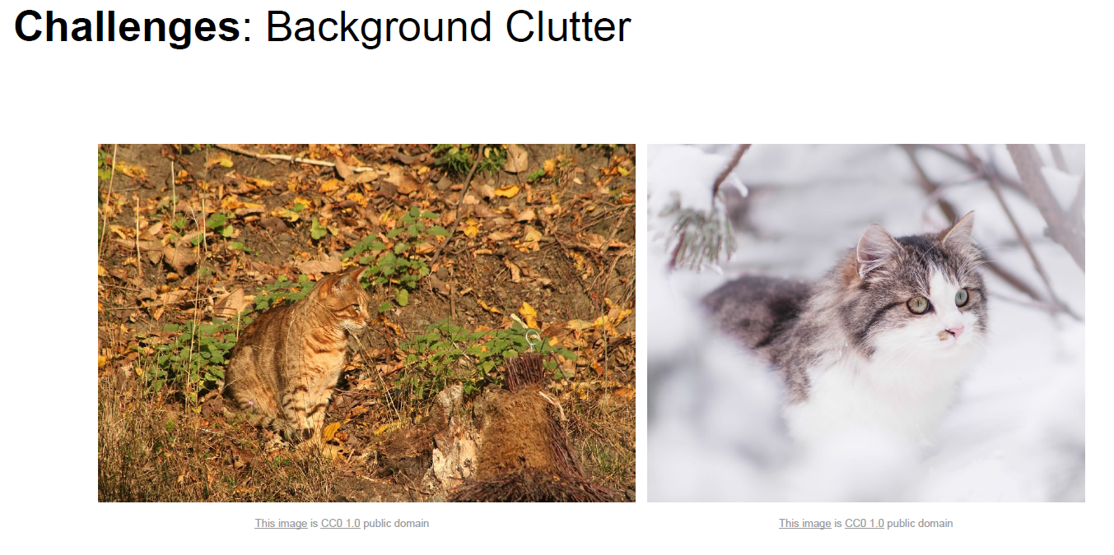
Image Classification Pipeline

Slide 11
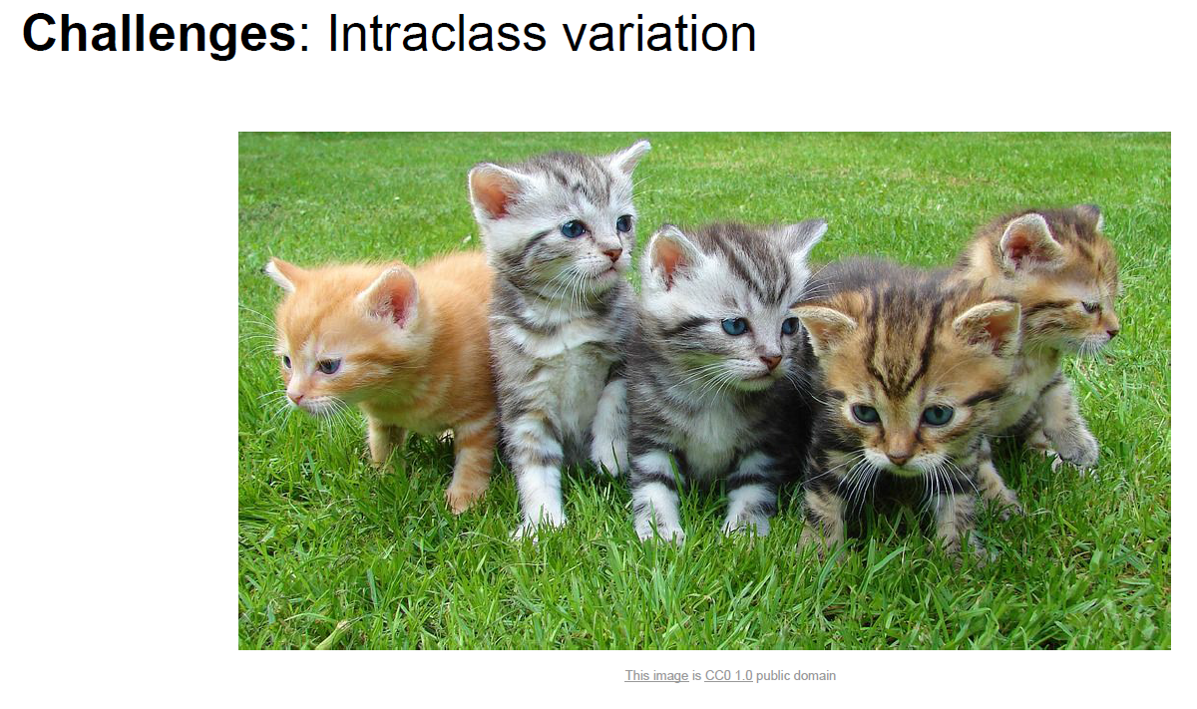
Image Classification Pipeline

Slide 12
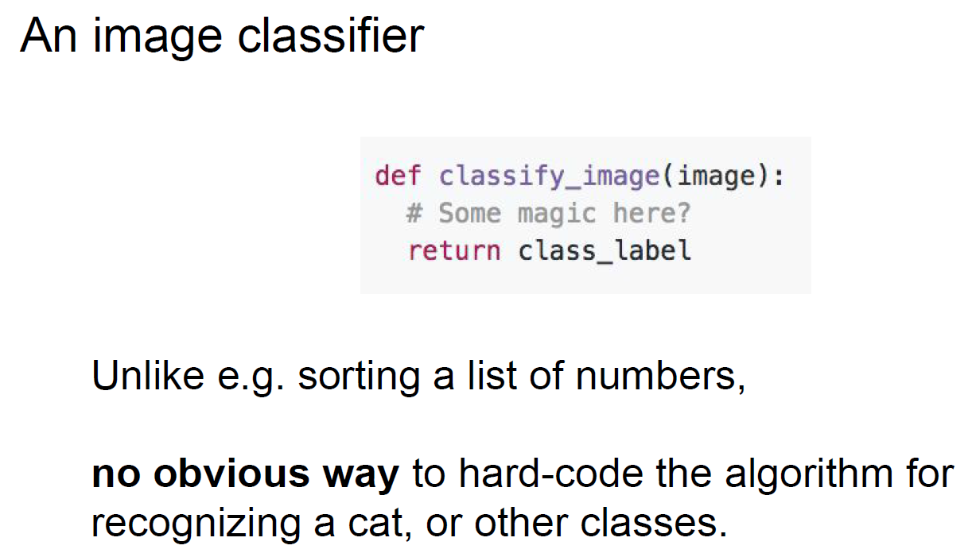
Image Classification Pipeline

Slide 13
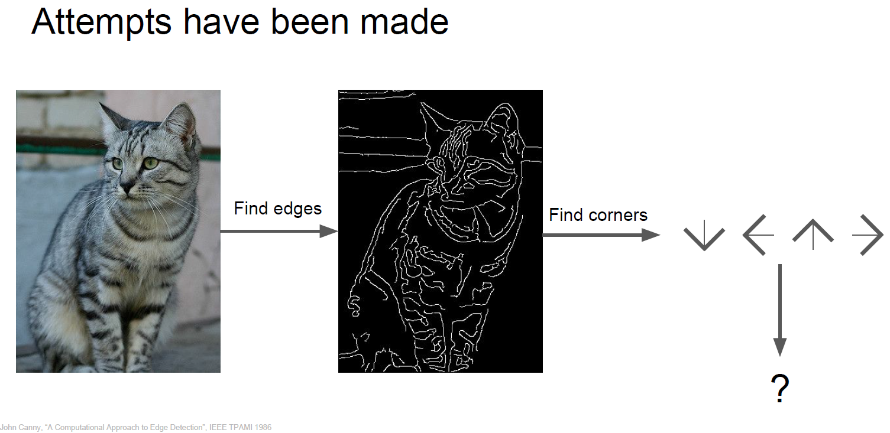
Image Classification Pipeline

Slide 14
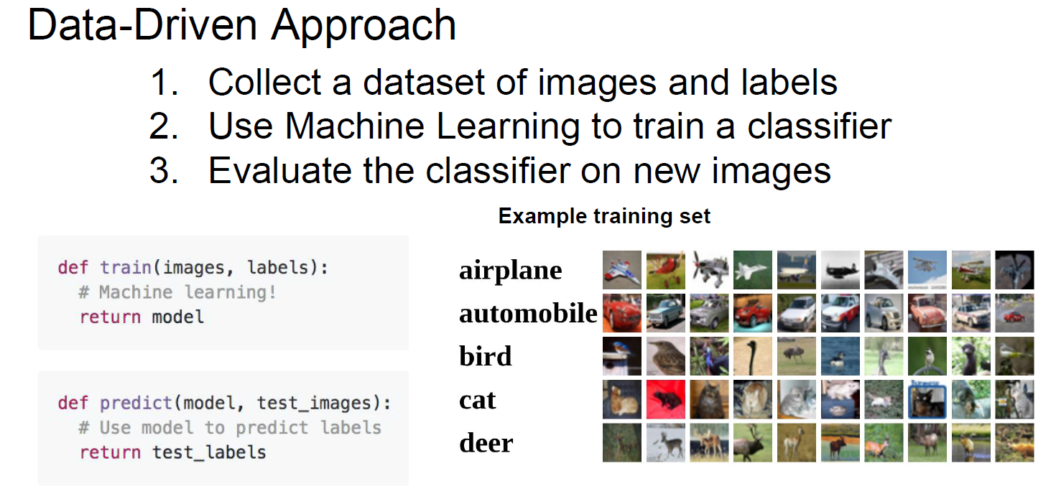
Image Classification Pipeline

Slide 15
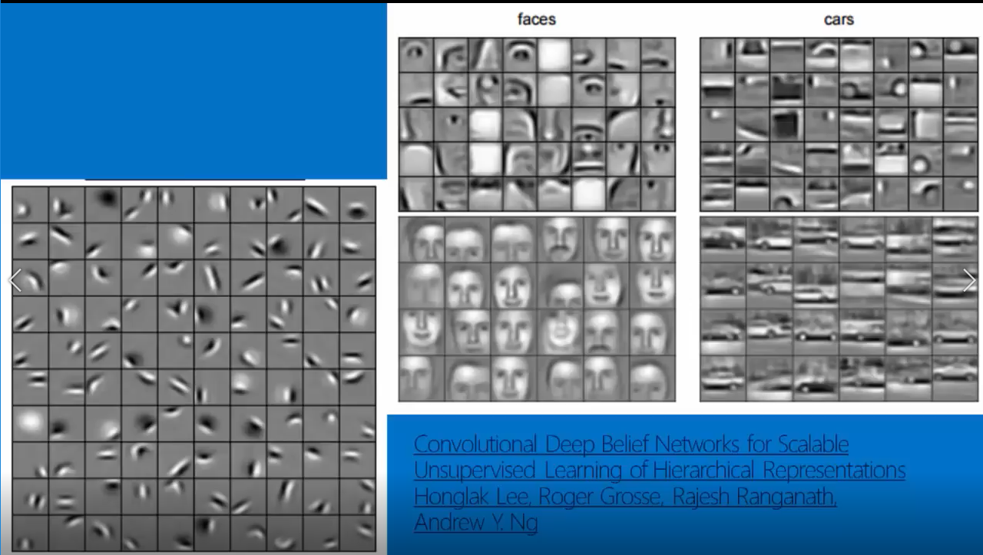
How Convolutional Neural Network Works ?

Slide 16
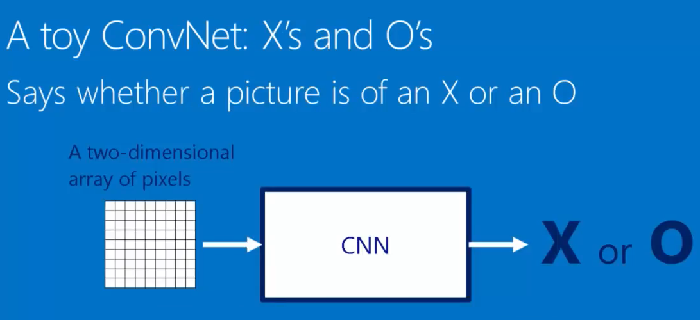

Slide 17
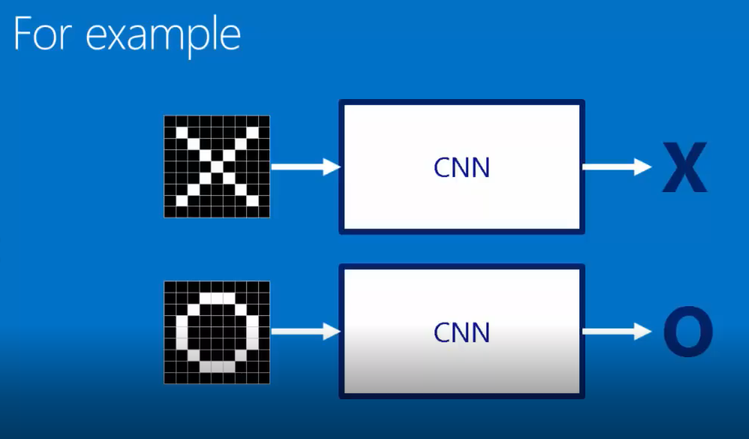

Slide 18
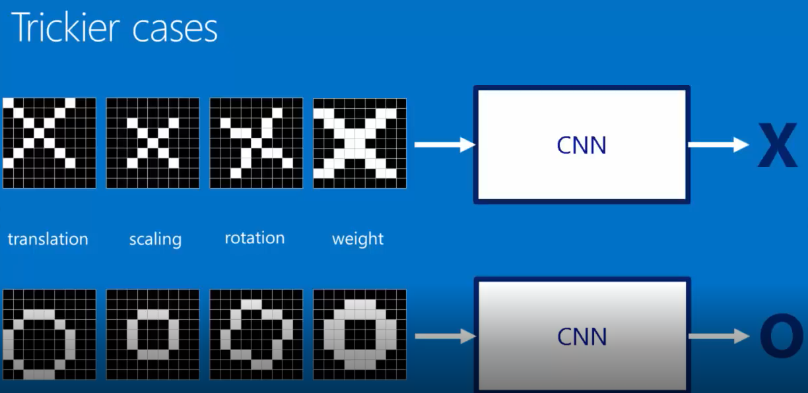

Slide 19
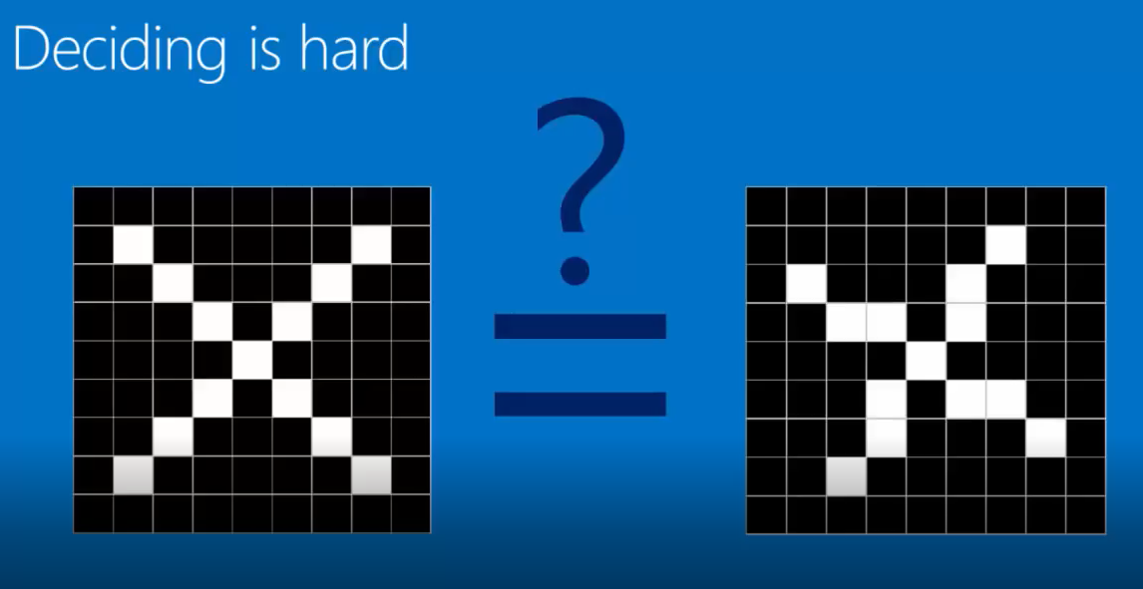

Slide 20
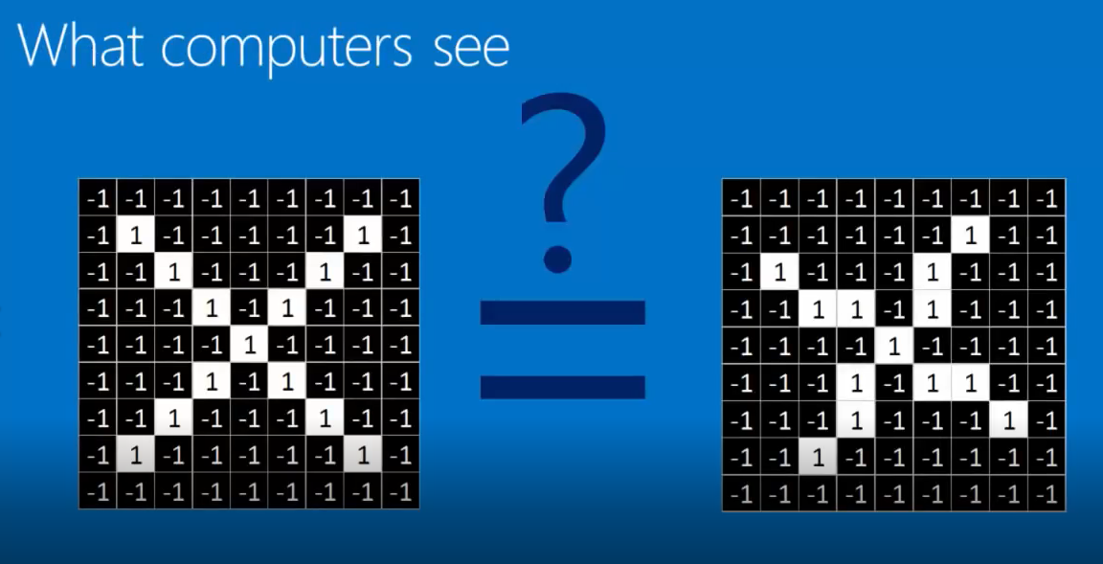

Slide 21
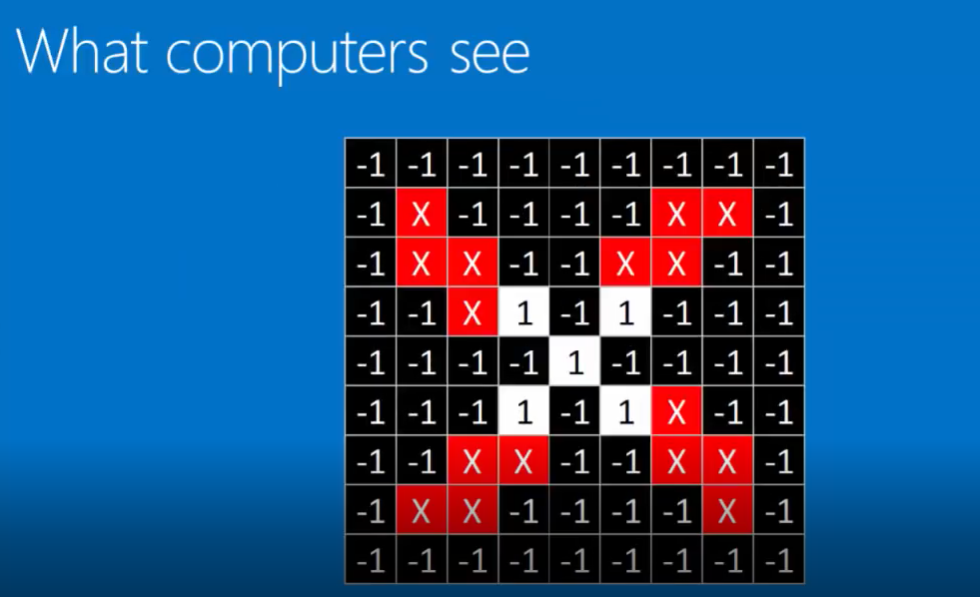

Slide 22
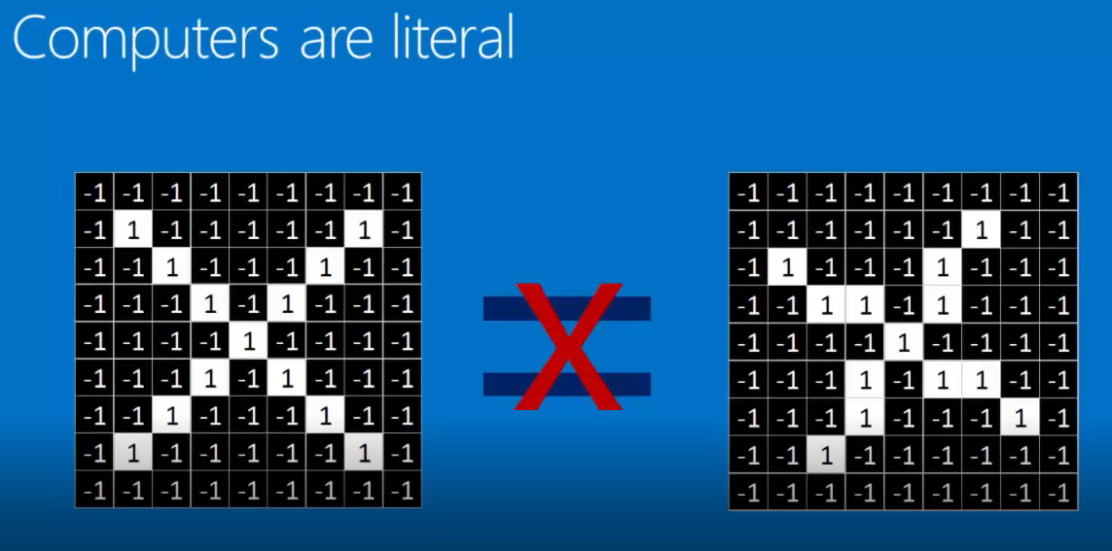

Slide 23
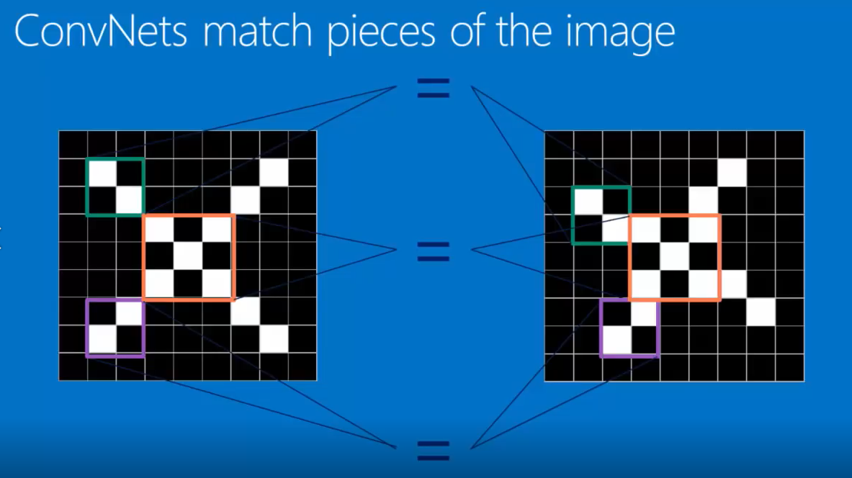

Slide 24
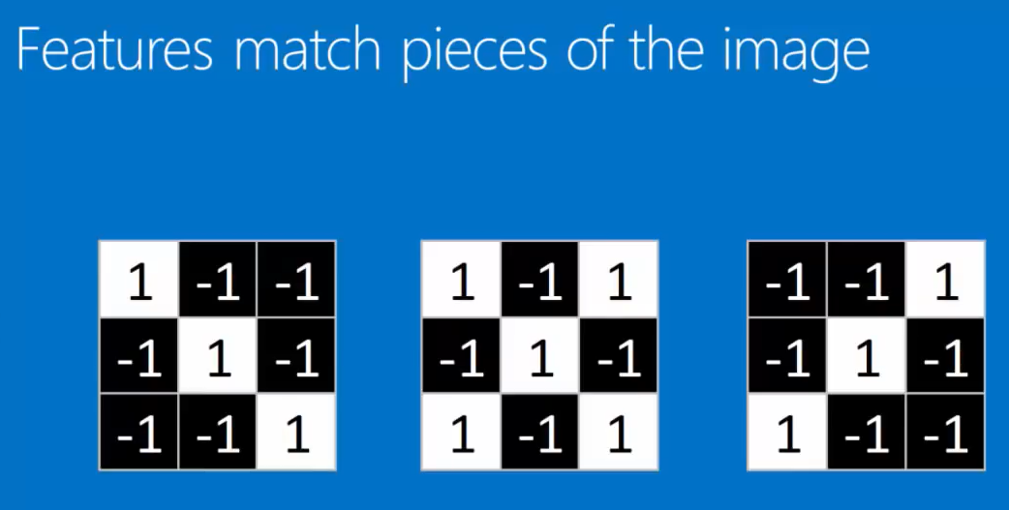

Slide 25
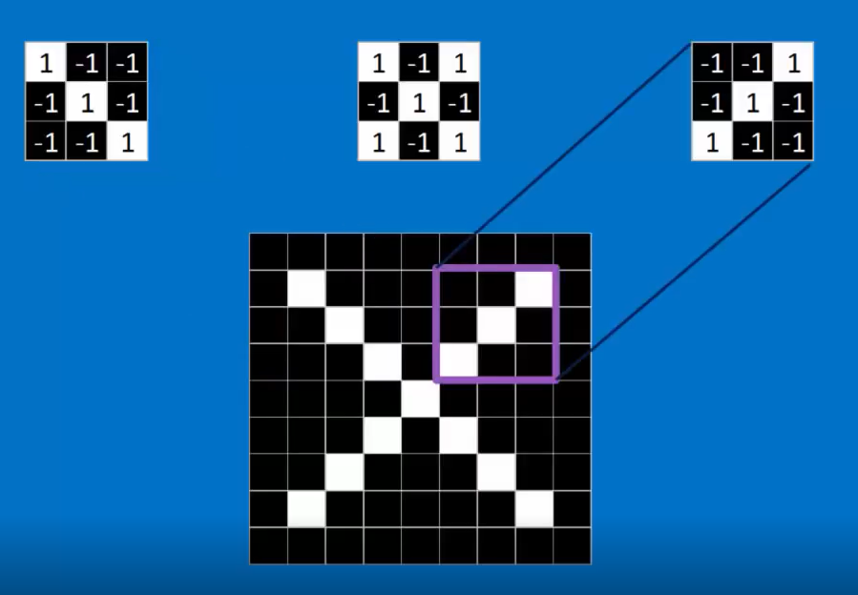
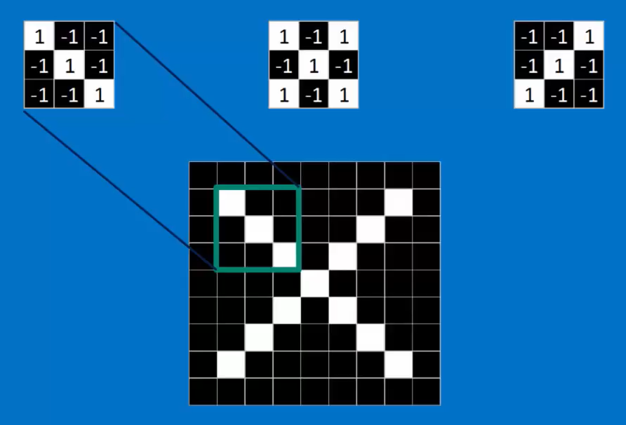
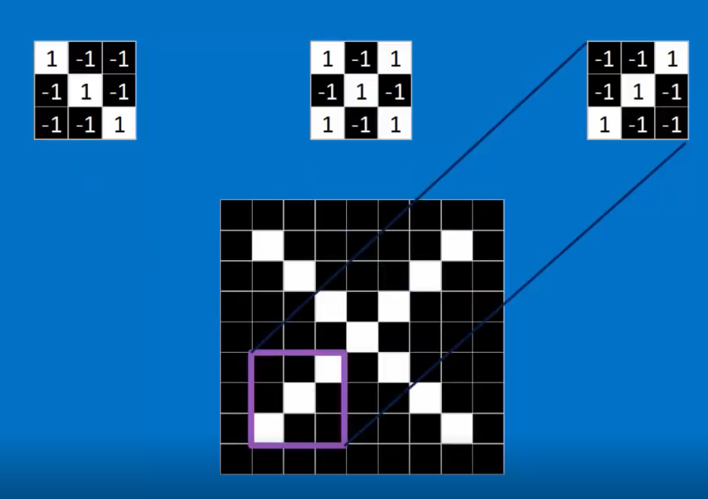
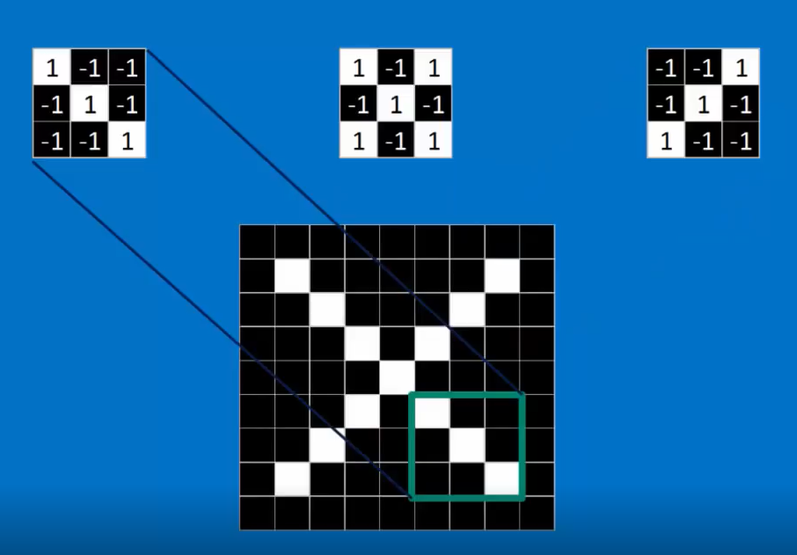
If you choose the right feature and put it in the right place, it matches the image exactly

Slide 26
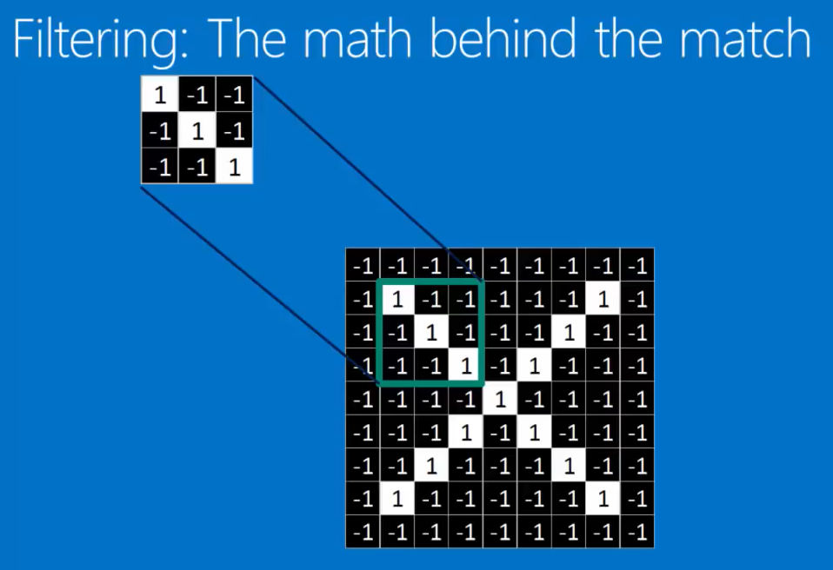
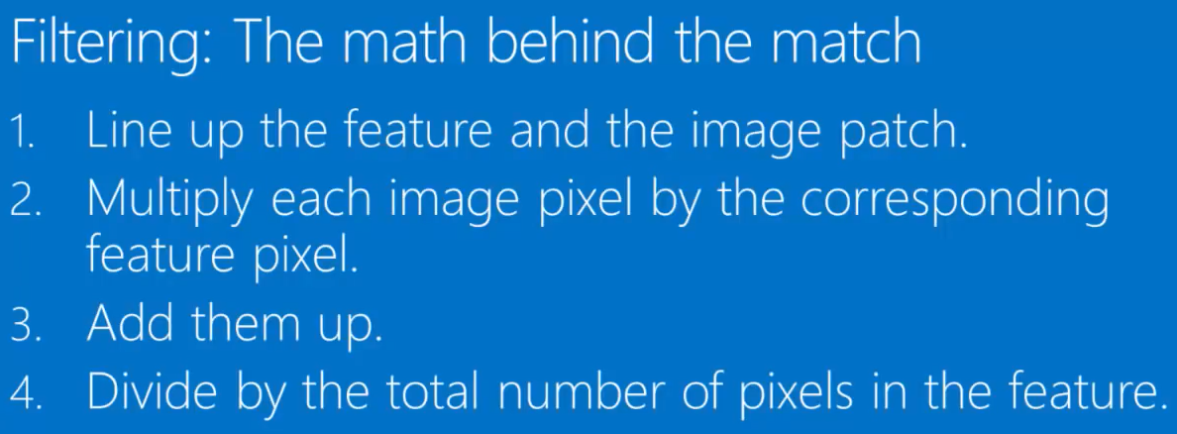

Slide 27
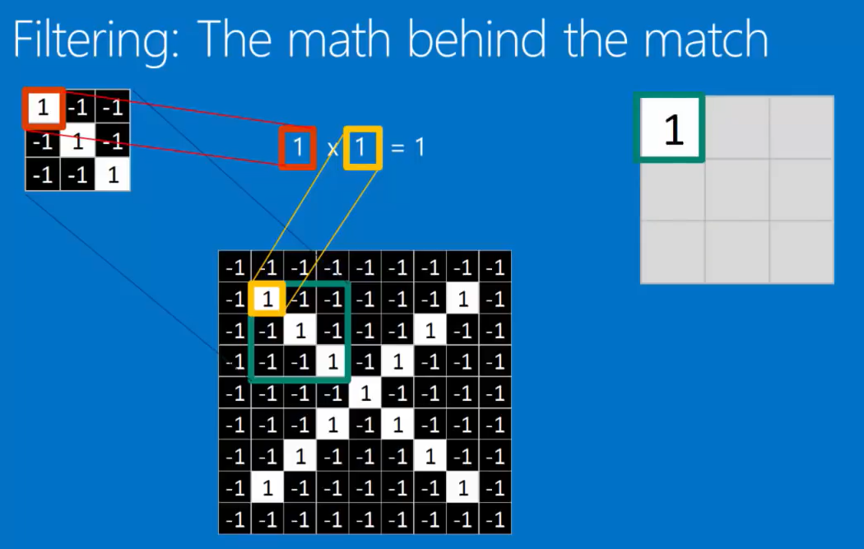
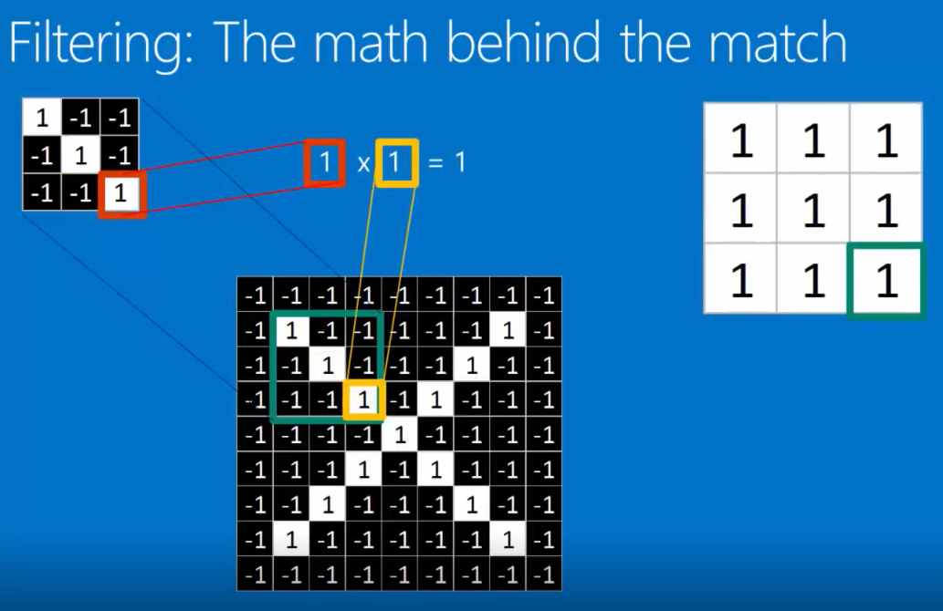
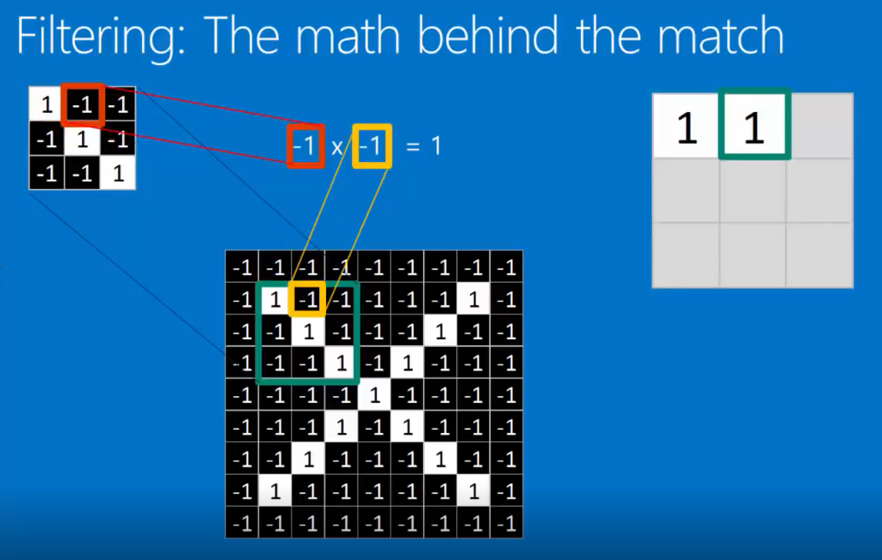

Slide 28
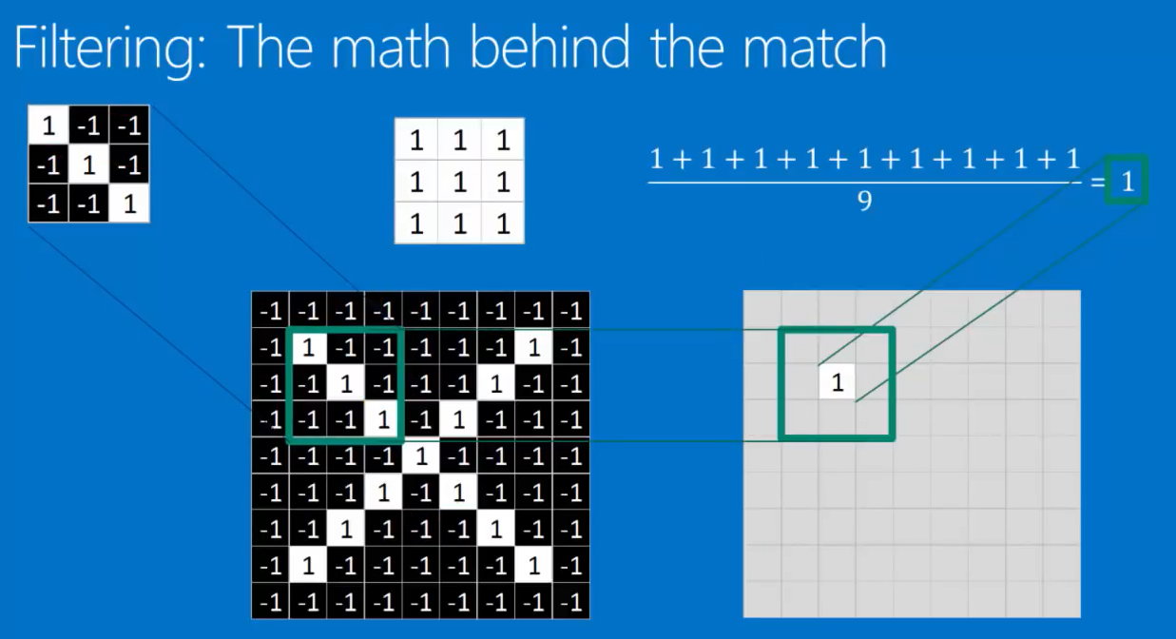
To keep track of where that feature was in the image, we put a 1
(meaning if we put 1 there we get a value of 10

Slide 29
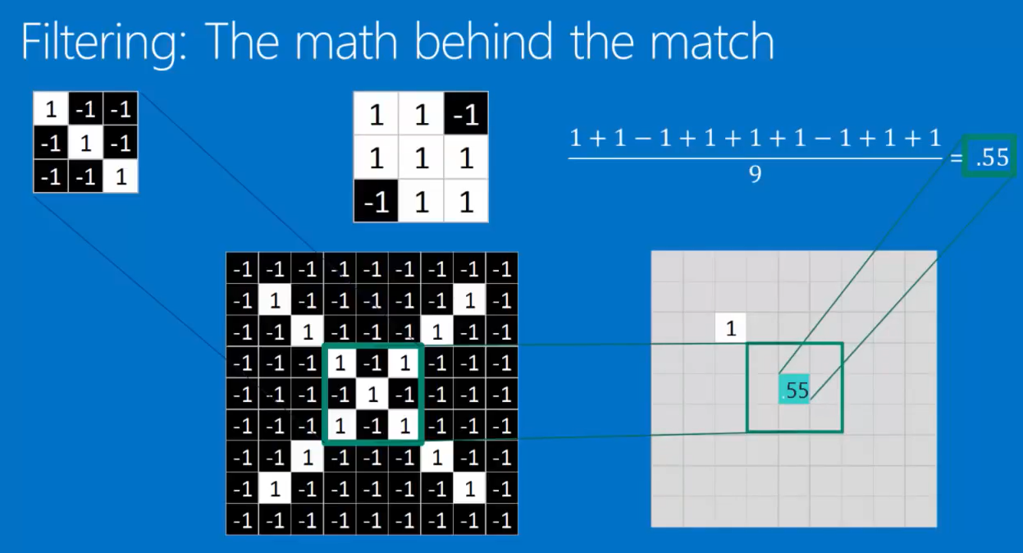
By moving our filter around to different places in the image,
we actually find different values for how well that filter matches or how well that feature is represented at that position;
This now becomes a map of where the feature occurs;

Slide 30
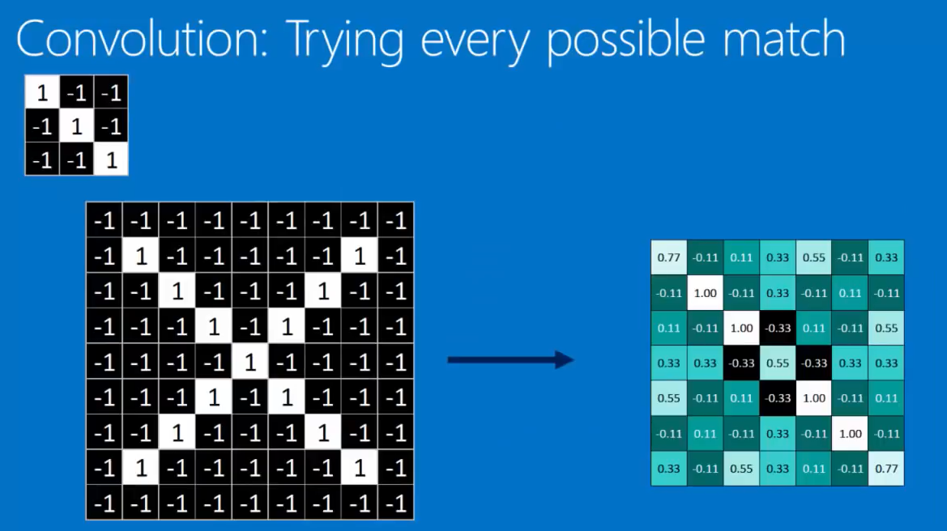
By moving it around to every possible position, we do convolution
(Repeated application of this filter over and over again)
We get a nice map across the whole image of where the feature occurs;
This feature is a diagonal line sliding downward left to right that matches the downward left to right X

Slide 31
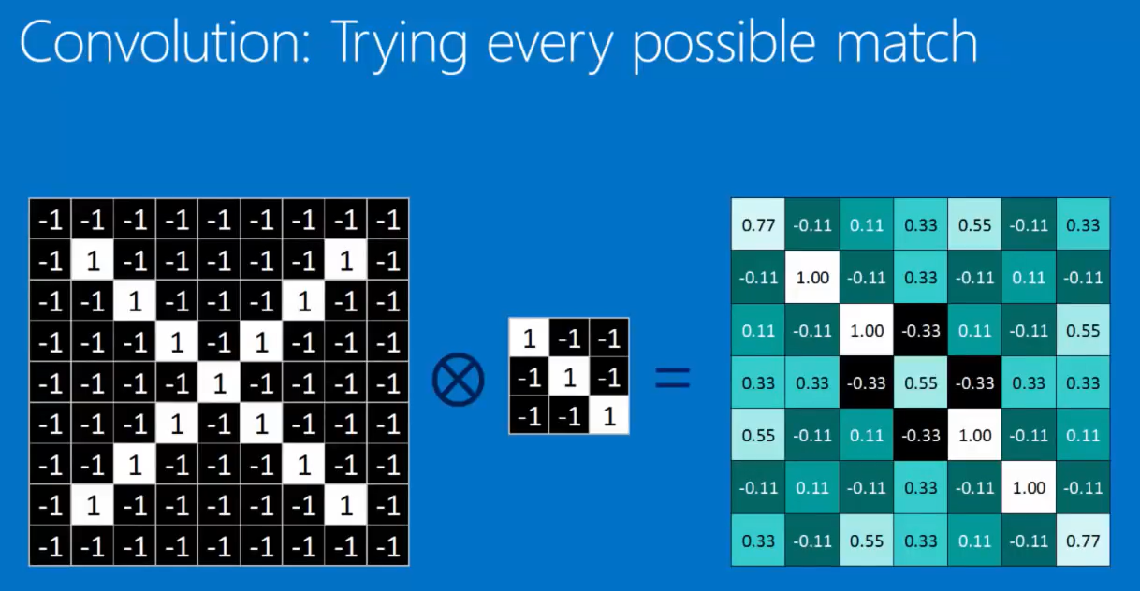
Short Hand Notation for the Convolution

Slide 32
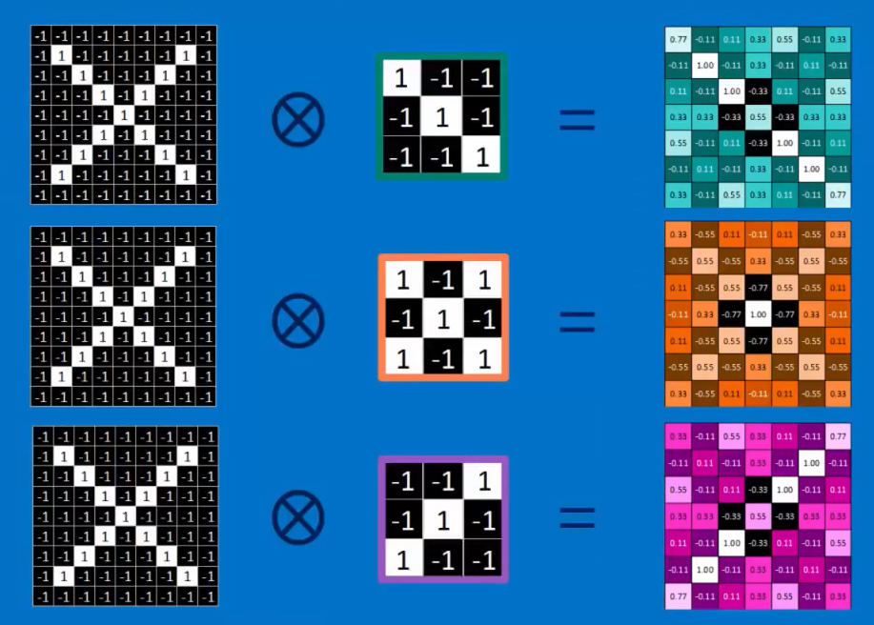
We repeat it with other filters and each time the map that we get of these features is consistent

Slide 33
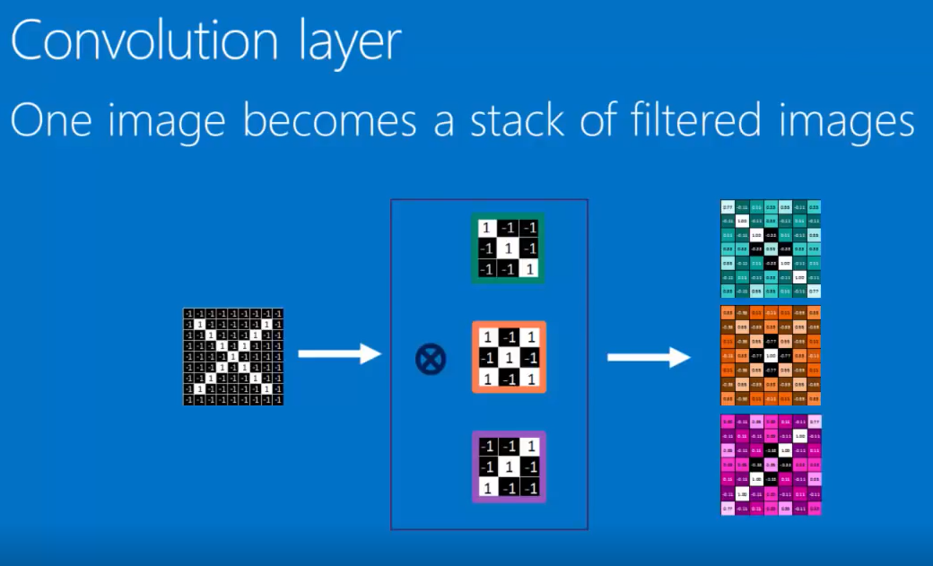
This act of convolving an image with a bunch of filters on features and creating a stack of filtered images is called Convolution Layer;
(A layer because we can stack it)

Slide 34
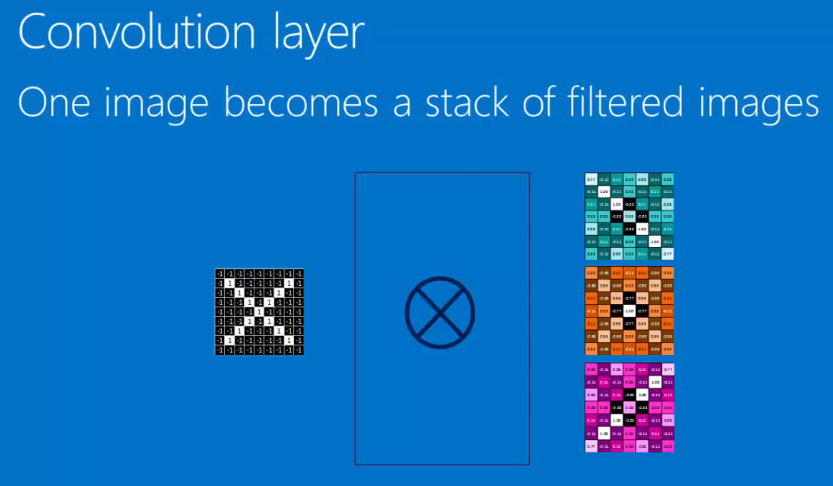

Slide 35
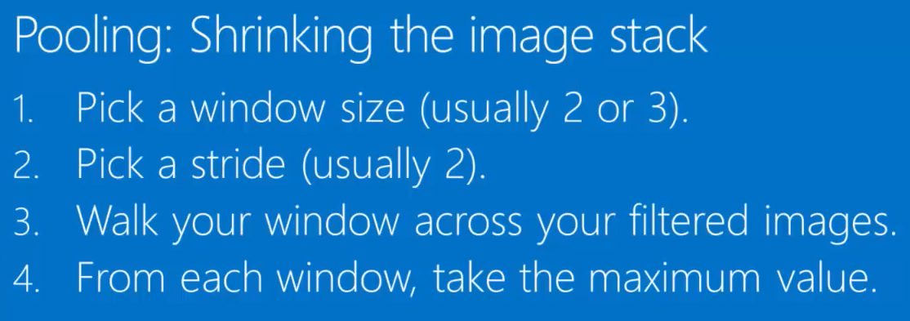

Slide 36
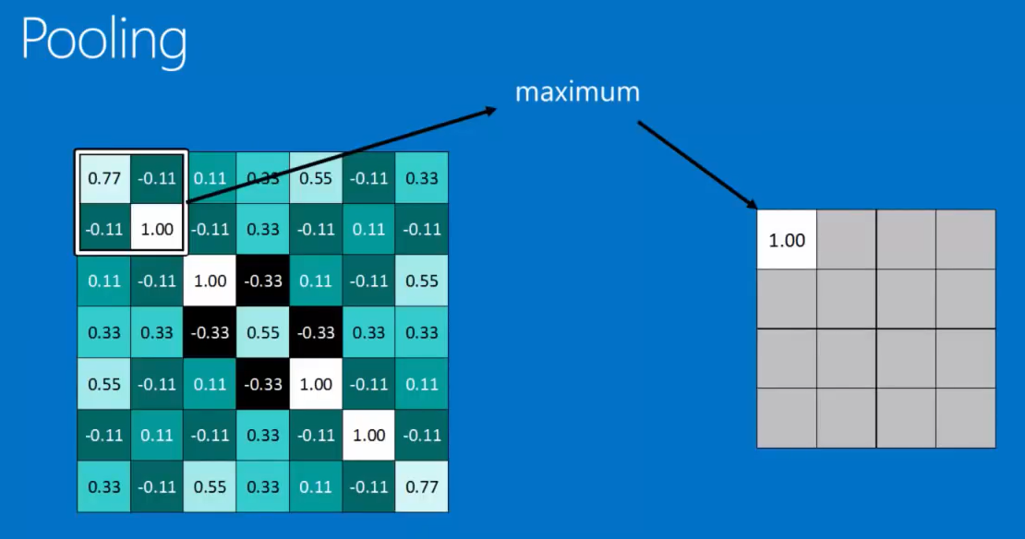
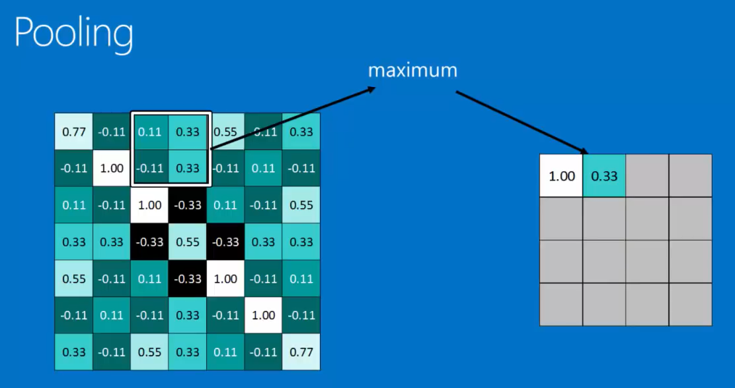
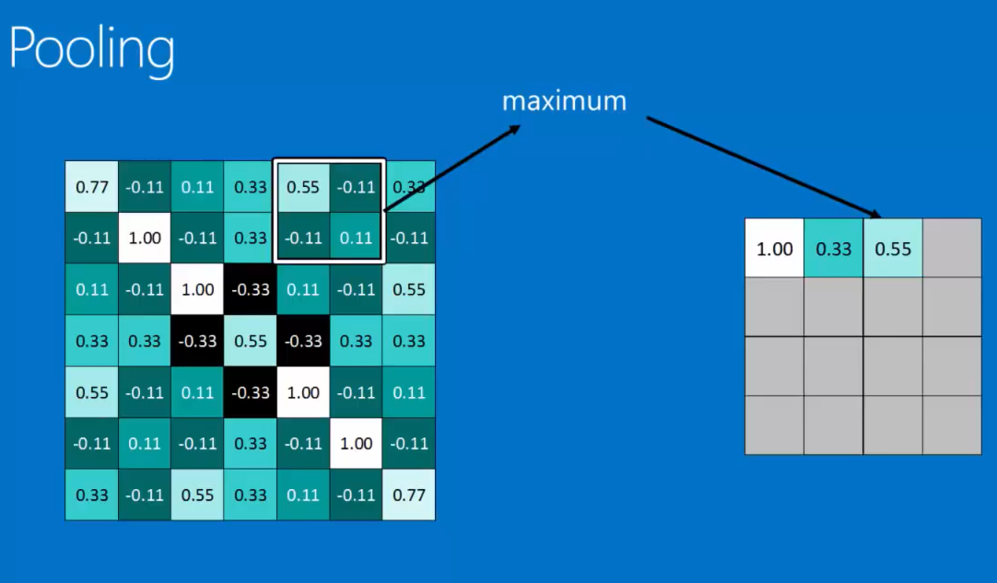
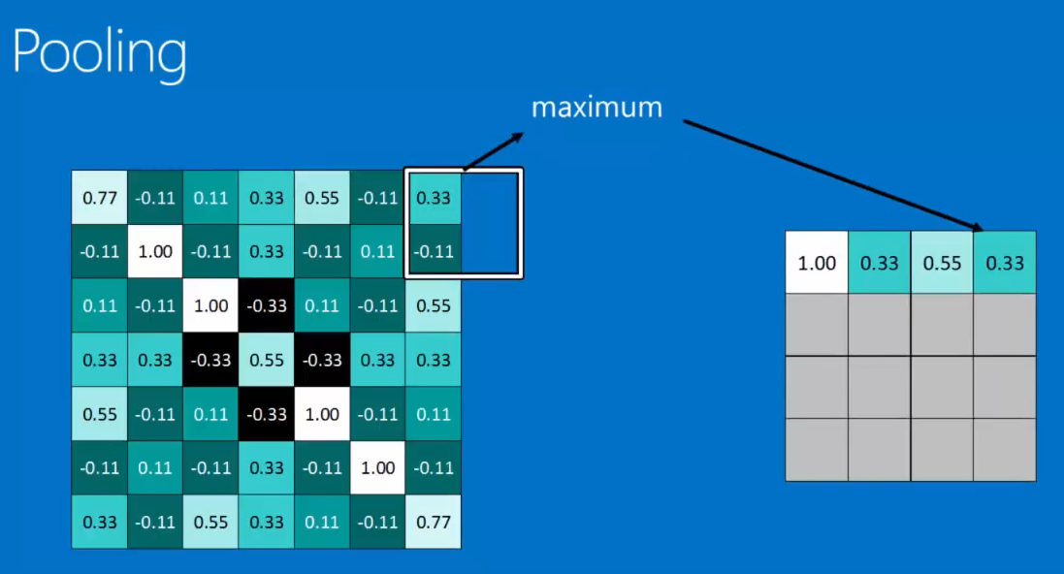
Here a Stride of 2 Pixel is taken

Slide 37
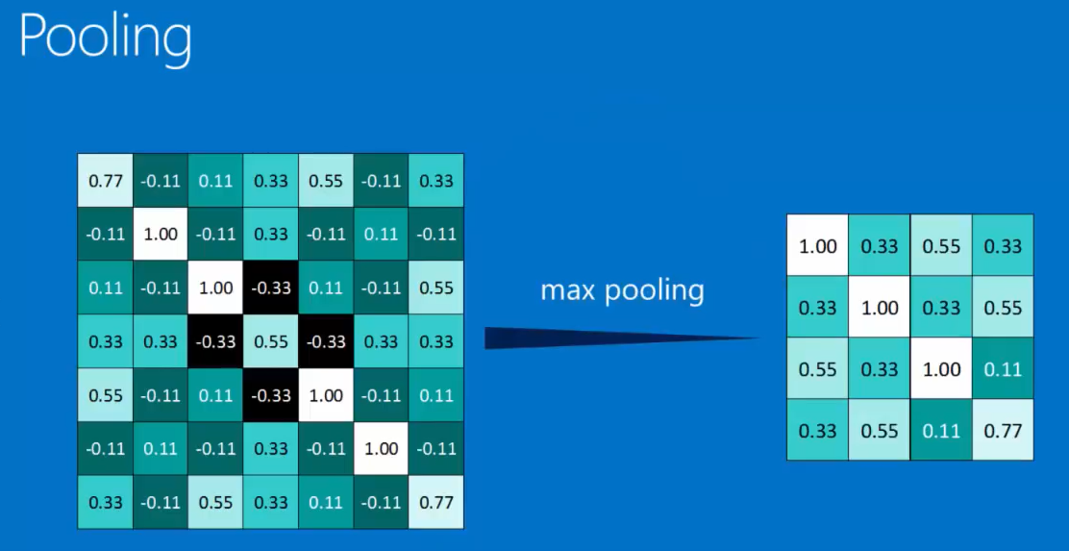
Wen done we get a similar but smaller pattern; We can still see high values across the diagonal;
(But instead of a 7x7 pixel image, we get a 4x4 pixel image);
(Pooling also does not care, where the maximum window occurs, So this also makes it little less sensitive to position)
(The way this plays out is that, if you are looking for a particular feature in an image, you can be little to the left or little to the right, little rotated and it will still get picked up)

Slide 38
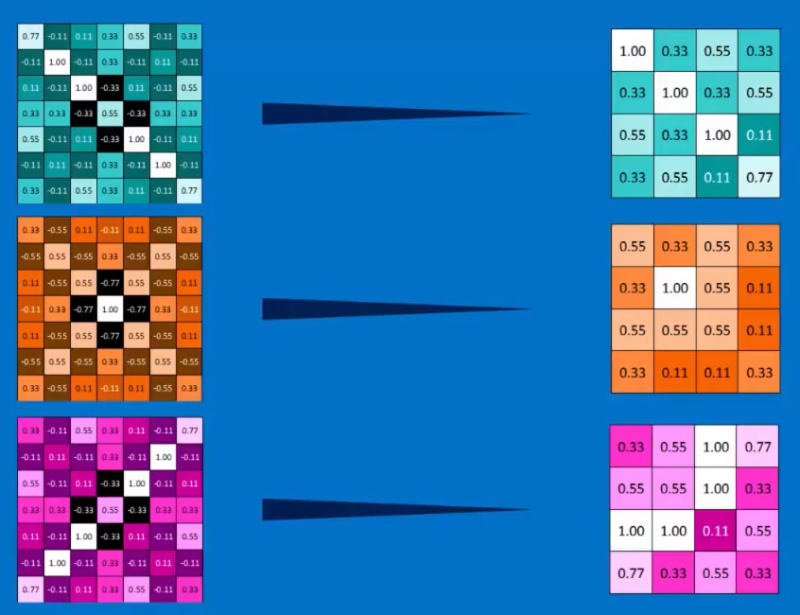
We do Max Pooling with all our stack of filtered images and get a smaller set of filtered images

Slide 39
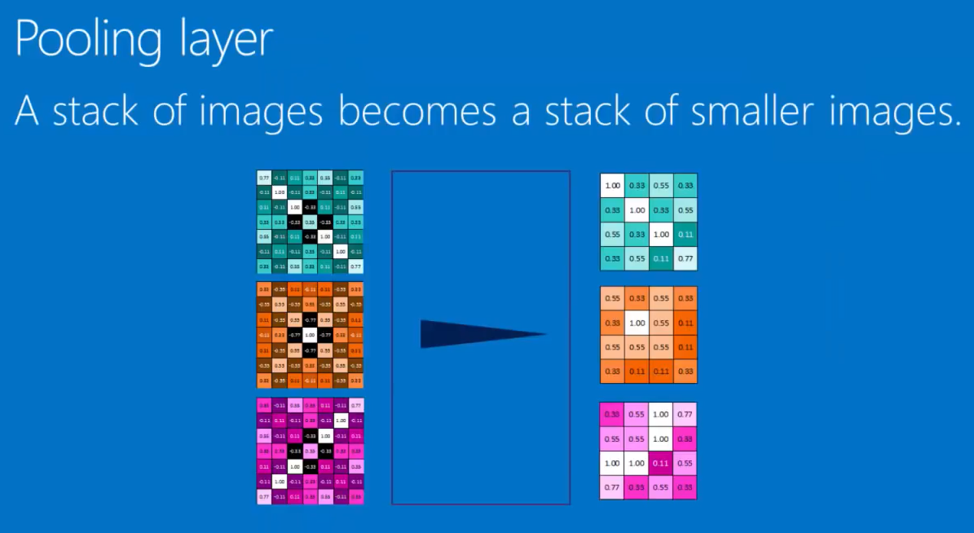

Slide 40
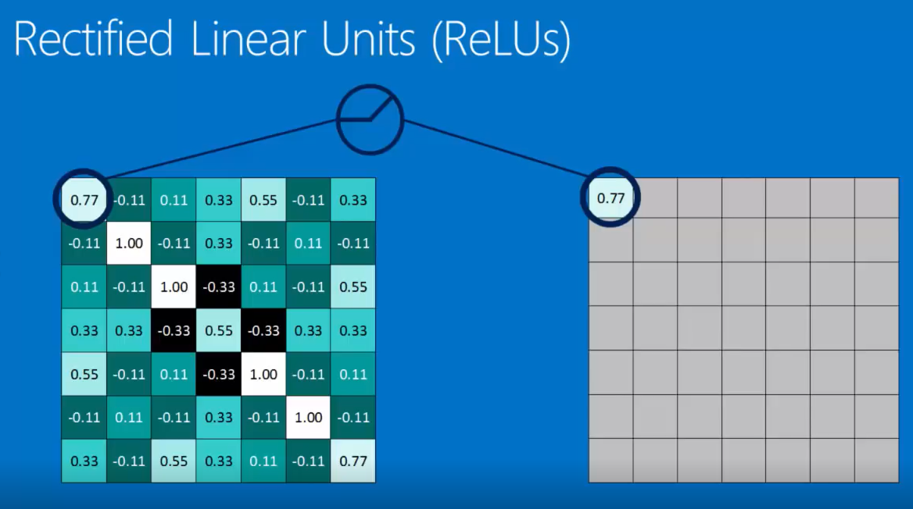
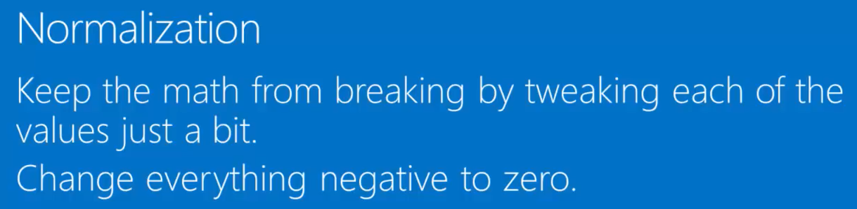
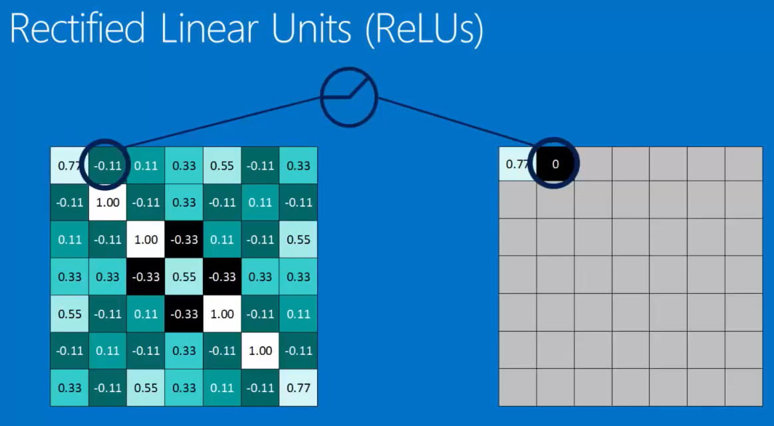


Slide 41


Slide 42


Slide 43

Each time the image gets more filtered as it goes through these convolution layers though Deep Stacking and gets smaller through these pooling layers

Slide 44

The Final Layer in our ToolBox is called a “Fully Connected Layer”.
Here every value gets a vote on what the values are going to be;

Slide 45


Slide 46


For the new images, after it goes through all the convolution and polling layers, based on the weights, each value gets to vote with, we get a nice average vote at the end
In this case, the vote for X gets weight of 0.92 and for O, we get 0.51
X is the winner, so the Neural Network Categorize this Input as an X

Slide 47

So in a fully connected layer, a list of features becomes a list of votes

Slide 48

Now the list of votes looks lot a like a list of feature values ,
So you can use the output of the one for the input of the next so you can get intermediate categories that are not final votes hidden units

Slide 49

Putting it all together a 2 dimensional array of pixels,
results in a set of votes for a category at the far end

Slide 50




Slide 51


The amount is adjusted by how big that error is,
the large error is adjusted a lot and small error adjusted a tiny bit

Slide 52

Doing that many times over lots of iterations helps all of these features and all the weights settle in, in what is called the minima and at that point the network is working optimally

Slide 53




Slide 54


Once sound frequencies are mapped as below it looks like images where convolutions apply;
In text, since word order matters, the window will be the entire sentence and slides over;

Slide 55



Slide 56





Slide 57





How it recognizing image patterns in MNIST

Slide 58





Slide 59
More Advanced state of the art CNN models

Slide 60
Convolutional Neural Networks
Illustration

Slide 61

Convolutional Neural Networks

Slide 62

Convolutional Neural Networks

Slide 63

Convolutional Neural Networks

Slide 64

Convolutional Neural Networks

Slide 65

Convolutional Neural Networks

Slide 66

Convolutional Neural Networks

Slide 67

Convolutional Neural Networks

Slide 68

Convolutional Neural Networks

Slide 69

Convolutional Neural Networks

Slide 70

Convolutional Neural Networks

Slide 71

Convolutional Neural Networks

Slide 72

Convolutional Neural Networks

Slide 73

Convolutional Neural Networks

Slide 74

Convolutional Neural Networks

Slide 75

Convolutional Neural Networks

Slide 76

Convolutional Neural Networks

Slide 77

Convolutional Neural Networks

Slide 78

Convolutional Neural Networks

Slide 79

Convolutional Neural Networks

Slide 80

Convolutional Neural Networks

Slide 81

Convolutional Neural Networks

Slide 82

Convolutional Neural Networks

Slide 83

Convolutional Neural Networks

Slide 84

Convolutional Neural Networks

Slide 85

Convolutional Neural Networks

Slide 86

Convolutional Neural Networks

Slide 87

Convolutional Neural Networks

Slide 88

Convolutional Neural Networks

Slide 89

Convolutional Neural Networks

Slide 90





Convolutional Neural Networks

Slide 91



Convolutional Neural Networks

Slide 92

Convolutional Neural Networks

Slide 93

Convolutional Neural Networks

Slide 94

Convolutional Neural Networks

Slide 95

Convolutional Neural Networks

Slide 96

Convolutional Neural Networks

Slide 97

Convolutional Neural Networks

Slide 98

Convolutional Neural Networks

Slide 99

Convolutional Neural Networks

Slide 100

Convolutional Neural Networks

Slide 101

Convolutional Neural Networks

Slide 102

Convolutional Neural Networks

Slide 103

Convolutional Neural Networks

Slide 104

Convolutional Neural Networks

Slide 105

Convolutional Neural Networks

Slide 106

Convolutional Neural Networks

Slide 107

Convolutional Neural Networks

